Slide 1
Introduction to Machine Learning Applications
Jason Kuruzovich
kuruzj@rpi.edu

Slide 2
Agenda
Conceptual
Value of Data
Data vs Information
Data Provenance
Data Wrangling
Notebooks
Numpy
Pandas

Slide 3
Homework 1
Feel free to use slack for any questions. Use the #homework channel
Provide as much details as you can.
Due officially Friday 1/24 noon.

Slide 4

THE CRISP-DM PROCESS MODEL
Cross Industry Standard Process for Data Mining
https://en.wikipedia.org/wiki/Cross_Industry_Standard_Process_for_Data_Mining

Slide 5
Let’s Talk About Data

Slide 6
“The world’s most valuable resource is no longer oil, but data”

Slide 7
Especially for Hackers.

Slide 8

$99 genetic testing
“In 2015, 23andMe began inking lucrative research agreements with pharma giants like Genentech and Pfizer, in addition to launching its own R&D program to sift through DNA samples from its more than 2 million customers.
https://www.wired.com/story/23andme-is-digging-through-your-data-for-a-parkinsons-cure/

Slide 9
How is data valuable for Amazon?

Slide 10
Data and Strategy
Why do companies open source code libraries? Why not data?

Slide 11
What is the difference between data and information?

Slide 12
What is the Difference between Data and Information?
Data is a building block
Information includes context and meaning
Knowledge is the "synthesis of multiple sources of information over time”
Wisdom is "the ability to make sound judgments and decisions apparently
without thought".^{[8][25]}
-wikipedia
By Longlivetheux (Own work) [CC BY-SA 4.0 (http://creativecommons.org/licenses/by-sa/4.0)], via Wikimedia

Slide 13
Data representing the same Information can have many Forms

Slide 14
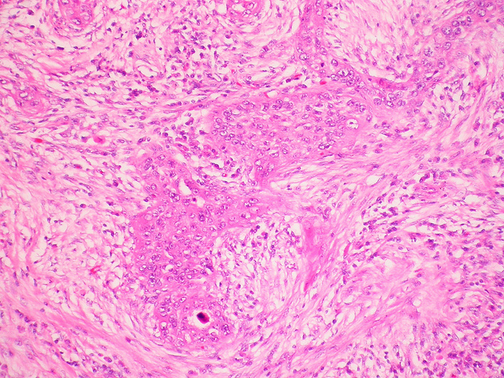
Data vs Information
Cancer = TRUE
Cancer = Mucoepidermoid carcinoma
Cancer =

Slide 15
Can a computer understand information or just data?

Slide 16
Computers and Information
“Barack Obama won Nobel Peace Prize in 2009. He is 44th president of United states.”
A classifier could determine that this is about politics
Entity and event tagger could extract “Barack Obama” as a person and ”Nobel Prize” as event
Semantic relationship between entities could be used to encode data.

Slide 17
Google Text
https://cloud.google.com/natural-language

Slide 18
Why would the government care about citizen’s access to data?

Slide 19
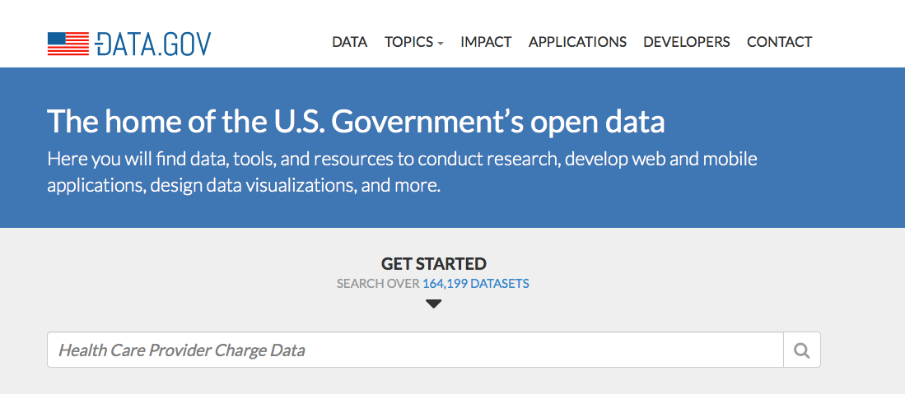
DATA.GOV
http://www.socrata.com

Slide 20
Open Data Platforms
Open data platforms like http://www.socrata.com provide ease of interacting with data via API or download

Slide 21
College Scorecard
With college scorecard, Government has made the shift from providing raw data to providing unbiased decision making tools (Information Apps)
The licenses is also public domain, meaning anyone can fork and use the code!!!!

Slide 22
Data
Provenance

Slide 23
“Data Provenance provides a historical record of the data and its origins. The provenance of data which is generated by complex transformations such as workflows is of considerable value to scientists^{[17]}. From it, one can ascertain the quality of the data based on its ancestral data and derivations, track back sources of errors, allow automated re-enactment of derivations to update a data, and provide attribution of data sources.”
Wikipedia (https://en.wikipedia.org/wiki/Data_lineage#Data_Provenance)

Slide 24
Data Provenance Answers
How were the data generated?
Collected via survey?
IOT (Internet of Things) devices
What is the sampling procedure?
Is it all the data or just a subset?
Was there a chance mechanism or was selection random?

Slide 25
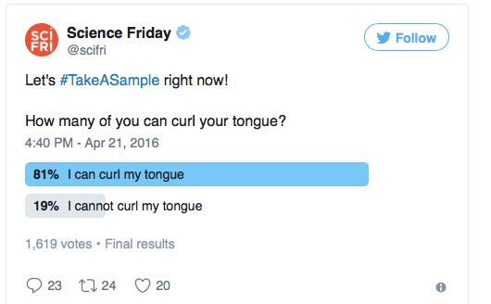
How is nature of the data collection likely to impact result?

Slide 26
Bias in Data
People didn’t respond because they were embarrassed or didn’t care.
People chose the answer that made them look good.
People just clicked the first answer.
People chose the answer that they thought most people would choose.

Slide 27
Summary
Data is a critical organization resource, that has strategic importance
Key terms data scientists should be aware of include data bias and data prominence
Citizen access to data can be an important governance tool

Slide 28
Please post challenges to Webex Teams

